Slide 1
Amazon Movies & TV Reviews Database Analysis
Ho Man Leung, Drazen Zack & Arthur Bertrand

Slide 2
Analyzing reviews using Natural Language Processing (NLP)
Exploratory Data Analysis (EDA)
Data Processing
Implementing Algorithms
Validation
Testing your Model

Slide 3
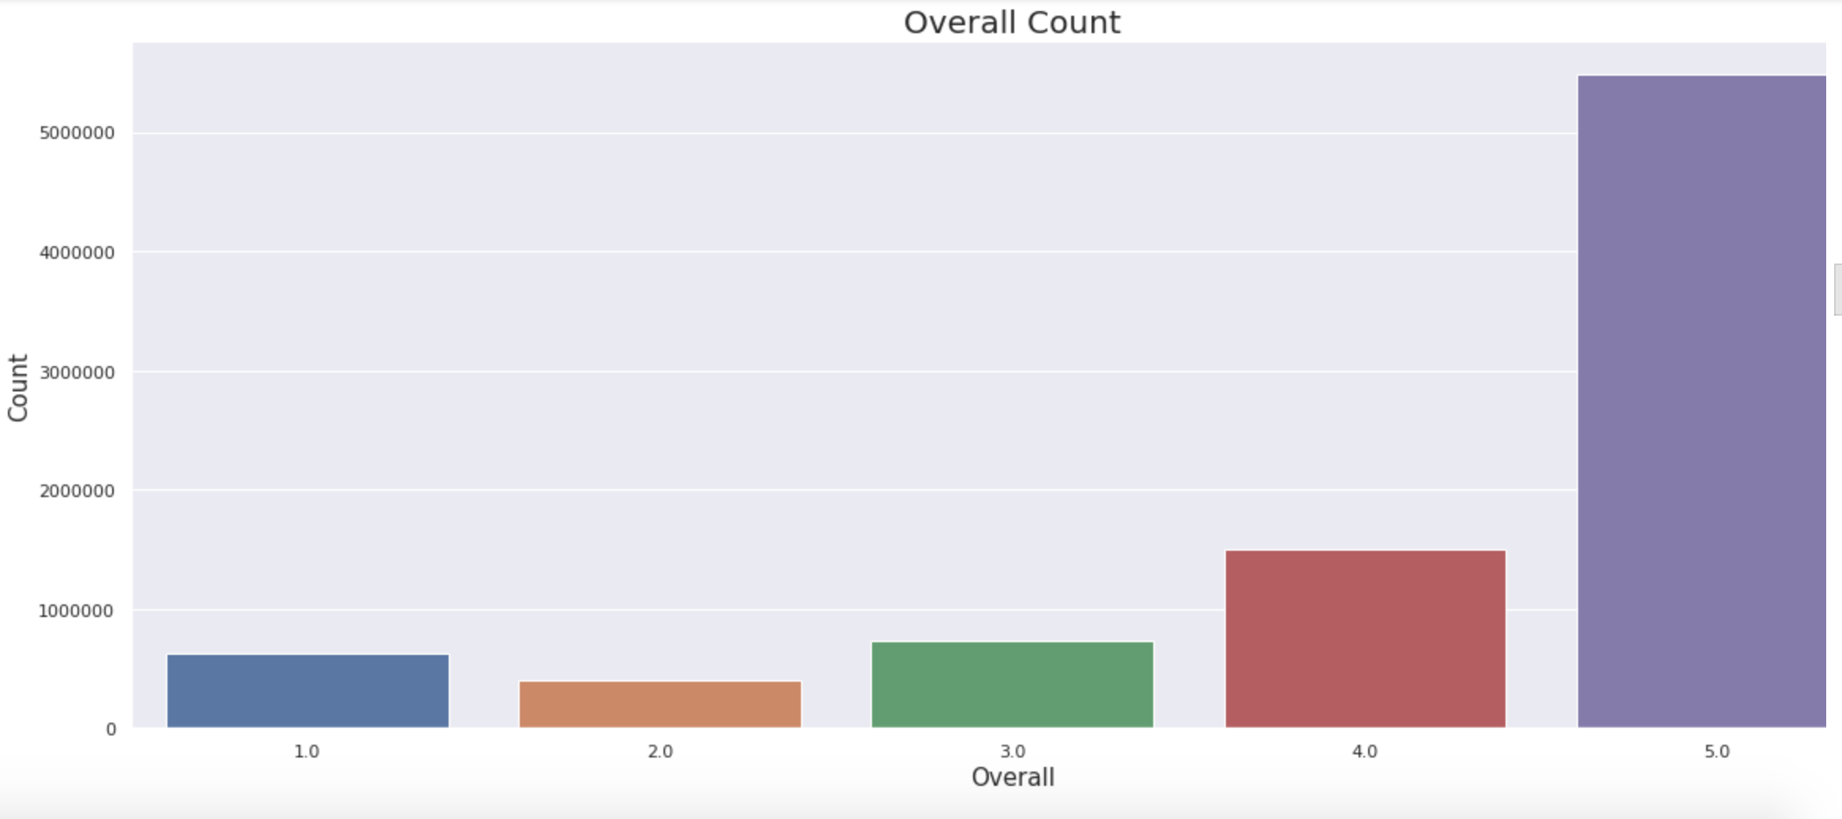
Exploratory Data Analysis (EDA)
Overall Representation of the Data

Slide 4
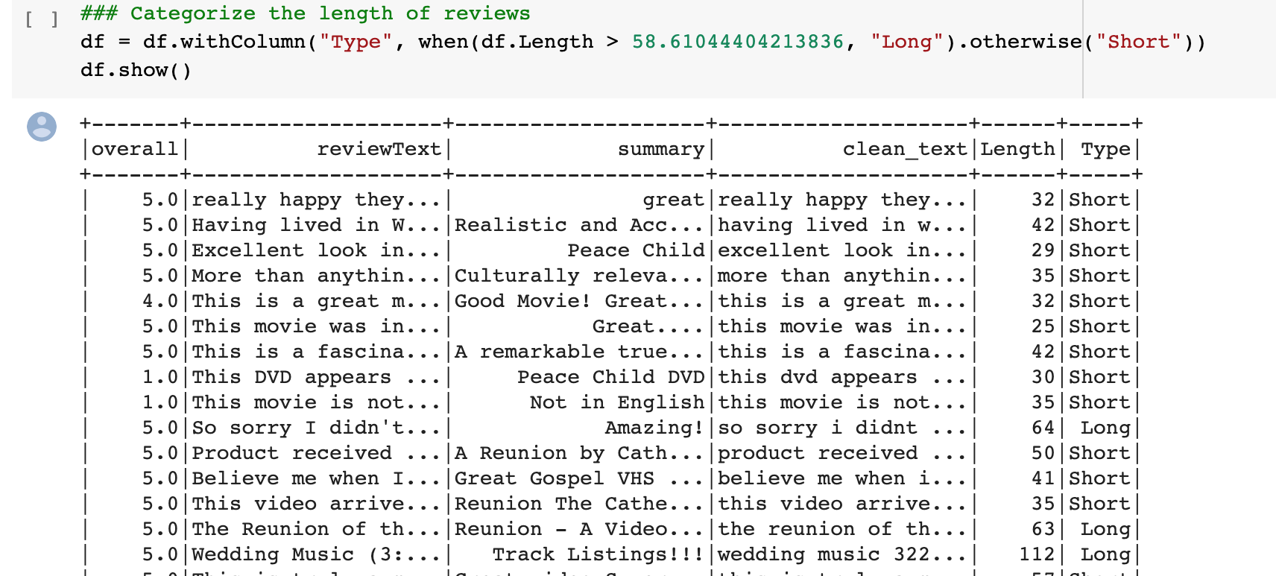
B. Categorize the Length of the Data

Slide 5
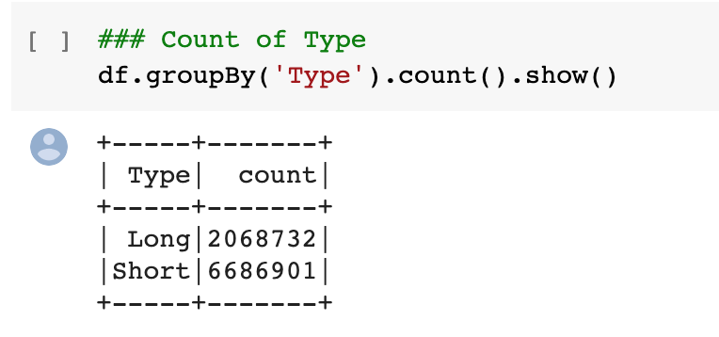
B. Length of the Data -- Results

Slide 6
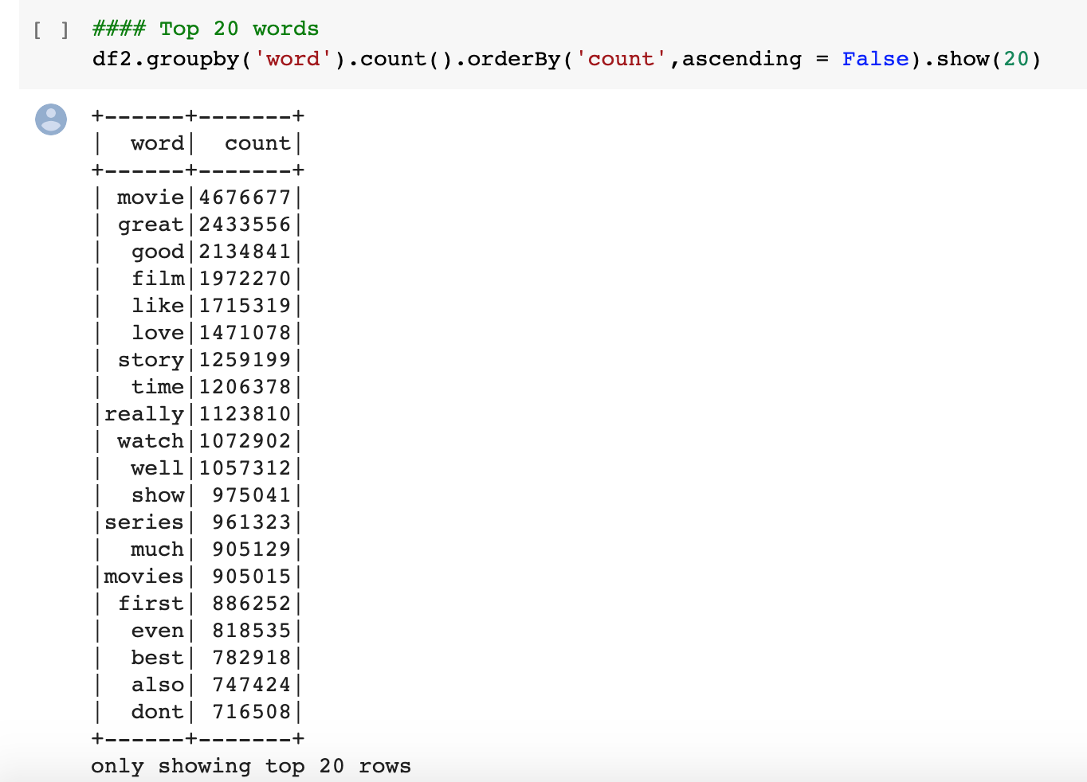
C. Most Common Words in the Data Set

Slide 7
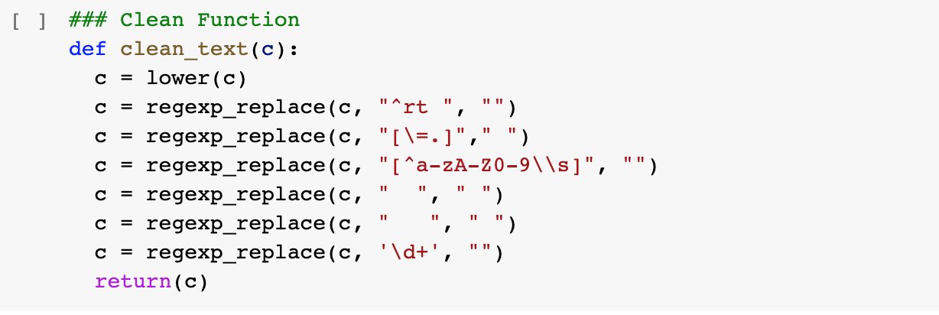
2. Data Processing
A & B. Remove Punctuations & Special Characters & Lowercase Words

Slide 8
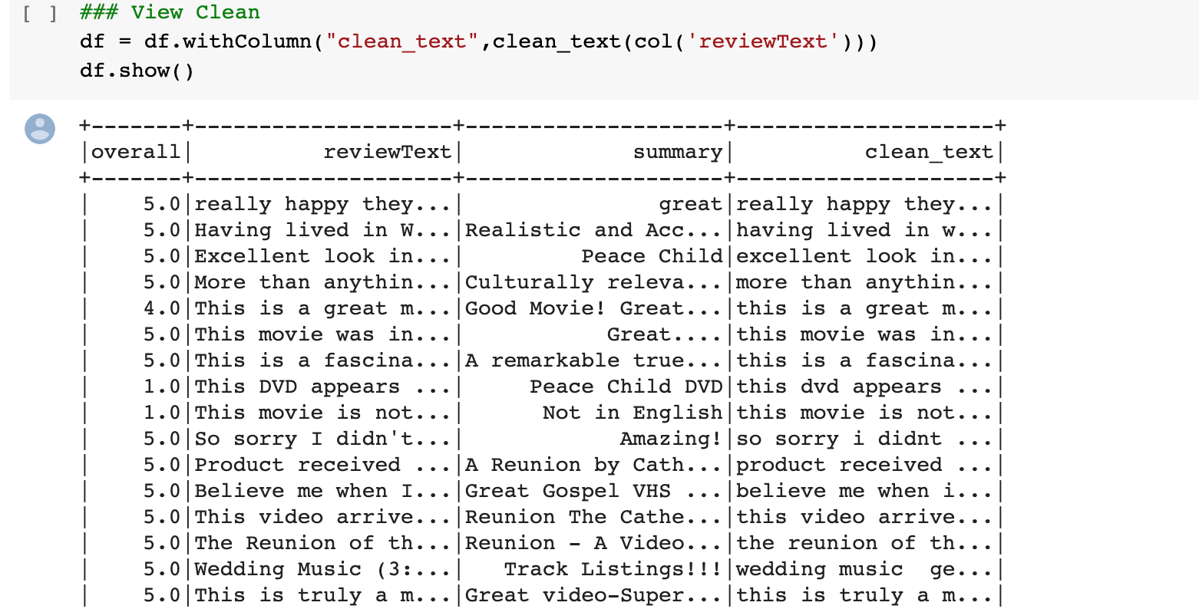
A & B. Results

Slide 9
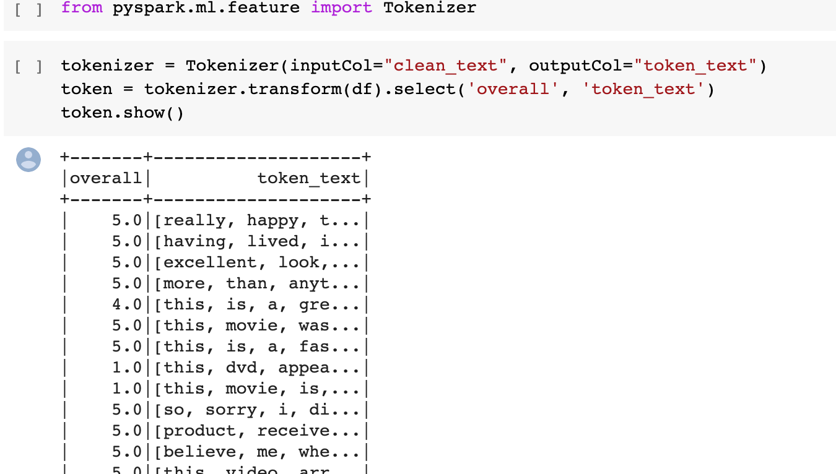
C. Tokenizer & Remove Stop Words

Slide 10
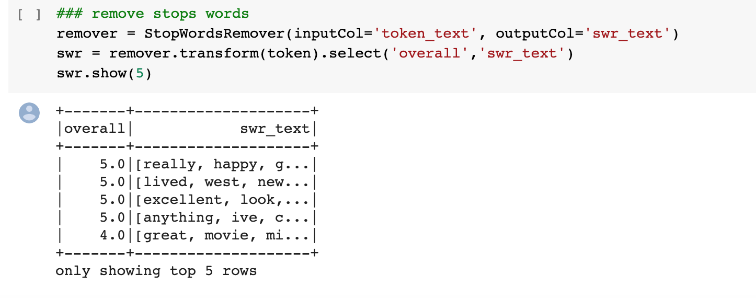
C. Tokenizer & Remove Stop Words (part 2)

Slide 11
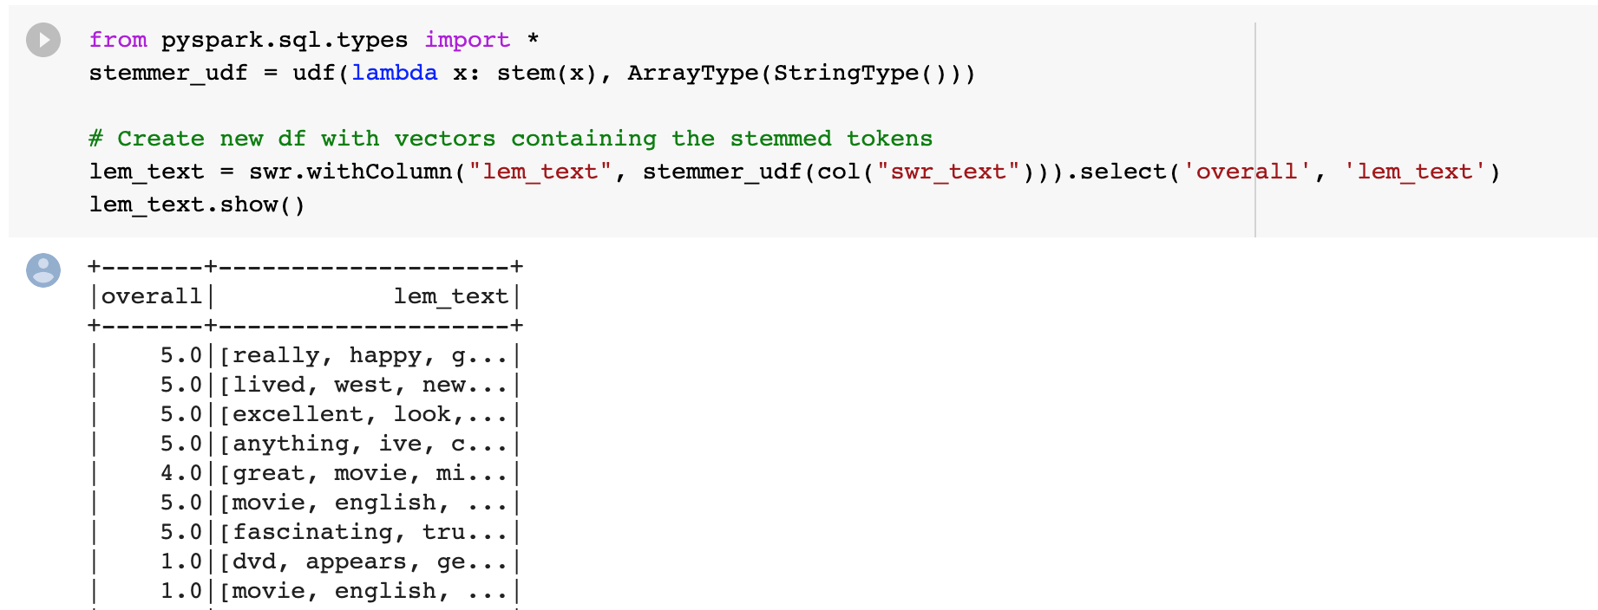
D. Lemmatization

Slide 12
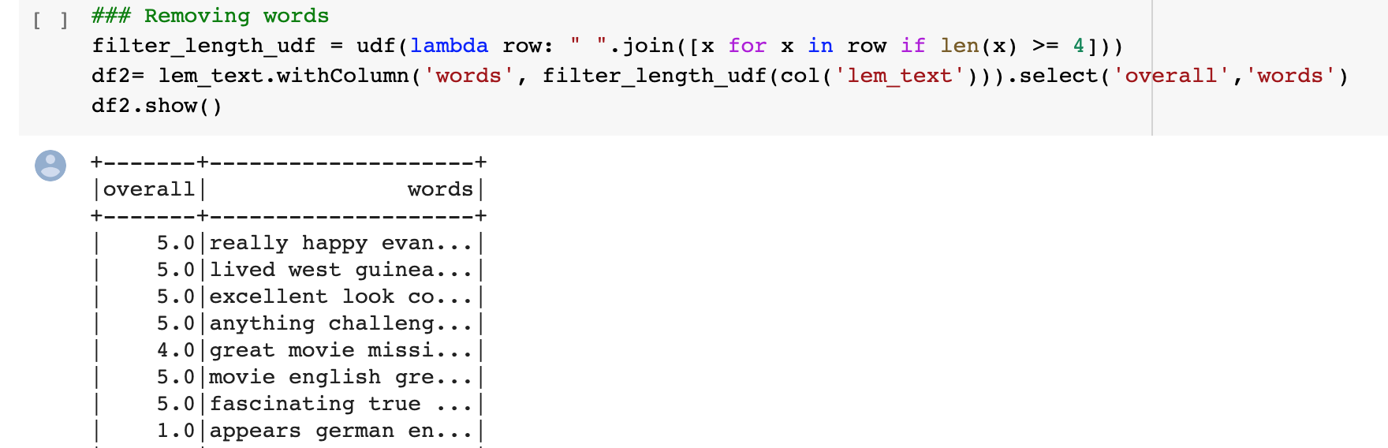
E. Removing Short Words

Slide 13
3. Machine Learning

Slide 14
4. Validation

Slide 15
5. Testing

